Slide 1

june 2025
Welcome to our new families

Slide 2
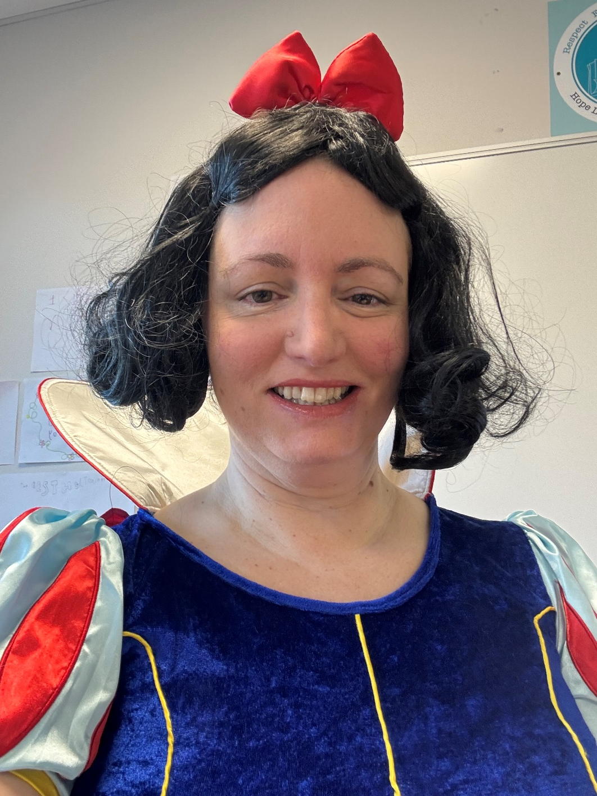
A little bit about me
I’ve been Head of Market Field School for nearly 3 years and have been a member of the Senior Leadership Team for 15.
Been at Market Field School since September 2006
I’ve been in the teaching profession since 2003, starting in Wales before moving to Lancashire
3 children, 2 of whom have some additional needs and have been/are going through mainstream education.
Have a cat
Disney mad
Love a dressing up day!

Slide 3
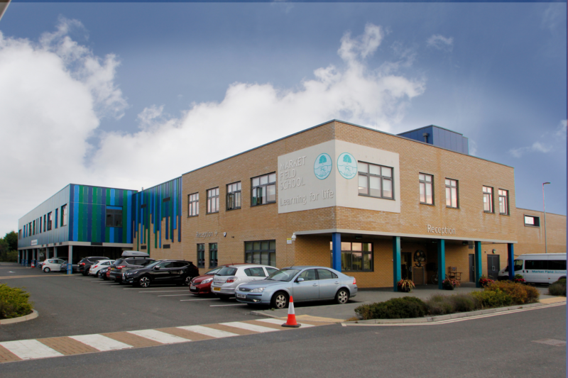
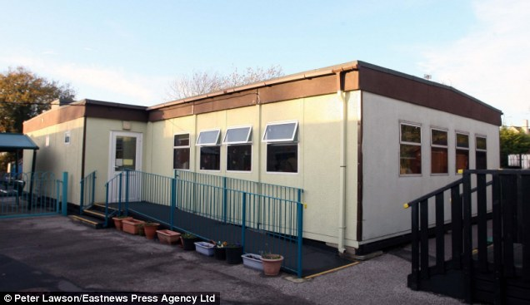
A brief history of market field school
Rebuilt in 2014. Built for 200, as of September 2025 we will have 380 students (and counting…)
School has been on this site since 1972. Originally built for 40 students.

Slide 4
Our vision and ethos
We will:
Give all our students an equal chance to succeed
Develop strong partnerships with home
Create a positive and caring environment where all our students achievements are celebrated
Value all our students
Ensure all our students are given every chance to reach their potential
Support all our students to be the very best version of themselves
Support our students to enjoy fulfilling and rewarding lives.
Our mission statement quotes:
Learning for Life
Be the best you can be

Slide 5
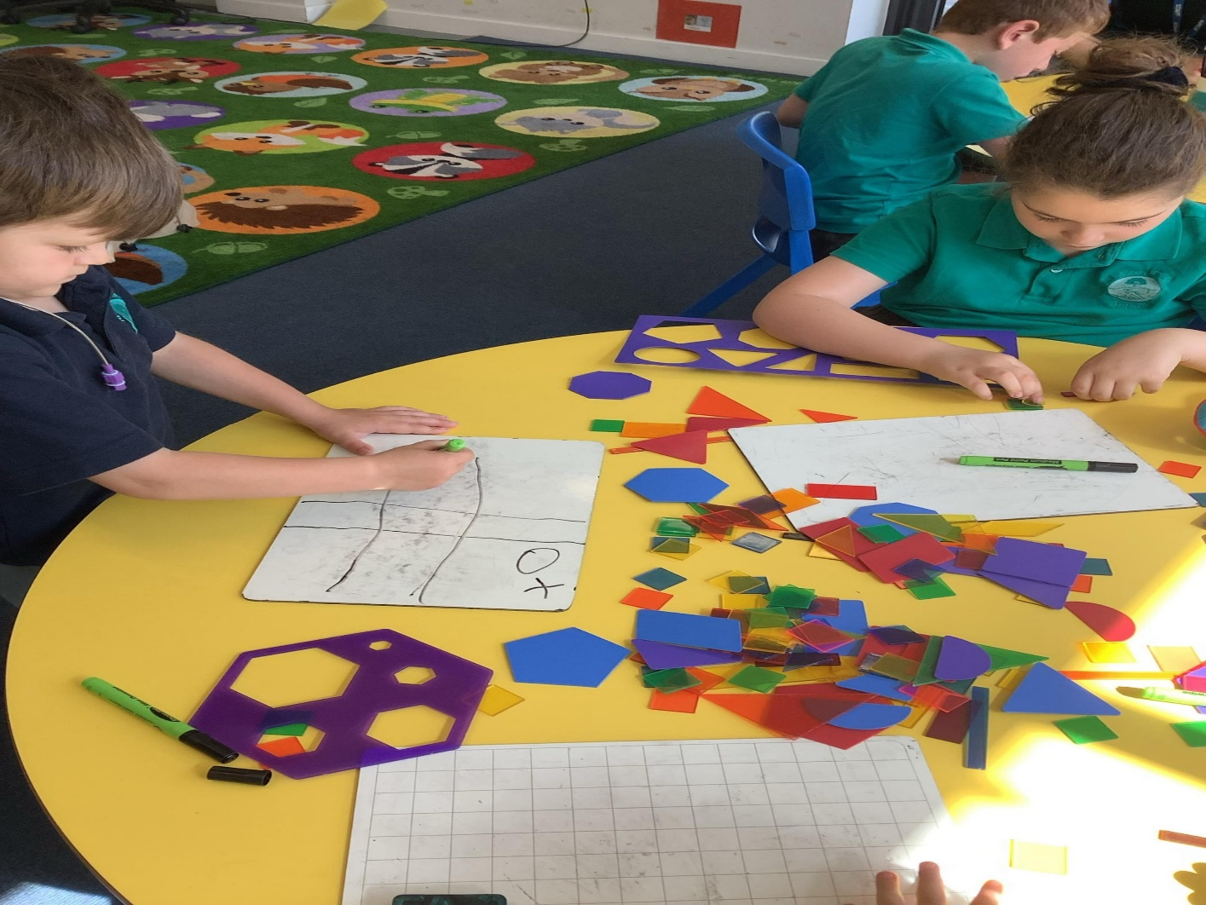
Our VALUES
RESPECT – For ourselves and each other
EXCELLENCE – Being the very best version of ourselves we can be – in our school work and in our play.
FRIENDSHIP – Supporting each other, showing kindness, empathy and caring

Slide 6

Our TRUST: An overview
CEO/Executive Head: Mr Gary Smith, OBE
Schools in our Trust: Southview School in Witham, Chatten School in Witham, Market Field College in Clacton, Lexden Springs School in Stanway and Hope Lodge in Stanway.

Slide 7
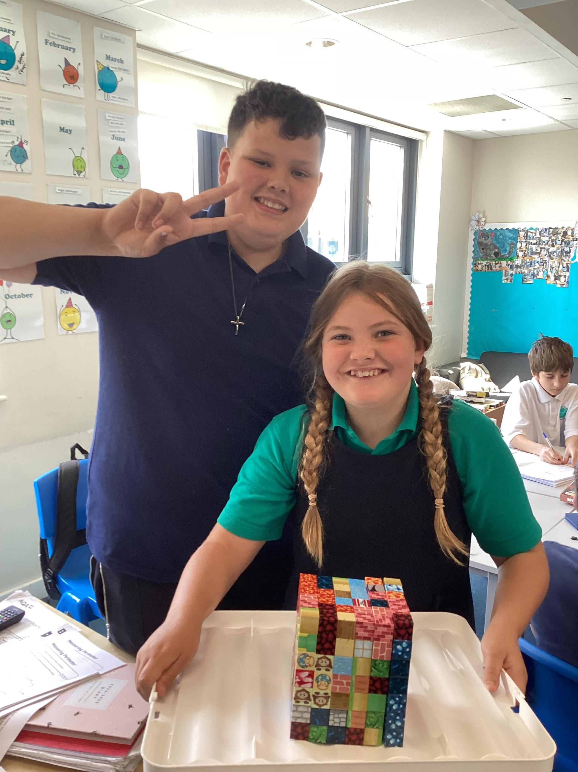
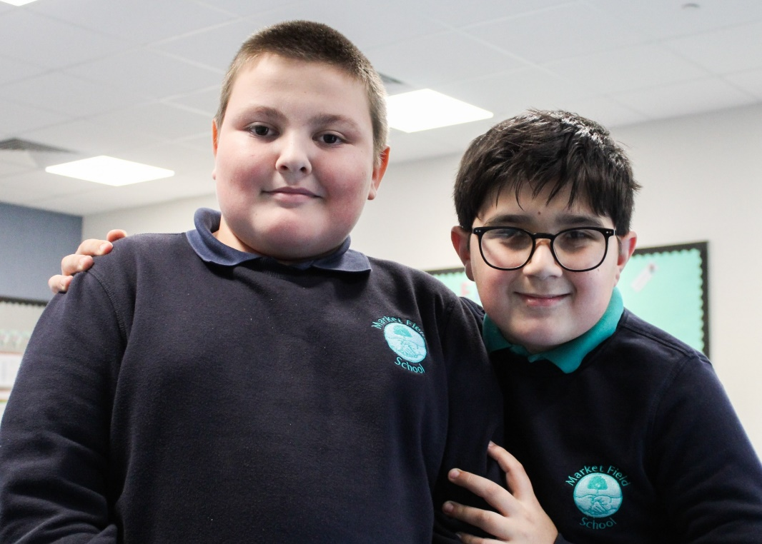
SCHOOL UNIFORM
No requirement for branded school uniform
Navy/jade polo shirt, navy sweatshirt, grey or black school trousers/skirt/shorts, green or blue summer dresses.
Plain unbranded black/blue tracksuit bottoms ok where formal trousers cause a problem
Sensible school shoes – no heels.

Slide 8
ATTENDANCE
190 DAYS IN A STANDARD SCHOOL YEAR
175 DAYS FOR FAMILY TIME AND HOLIDAYS

Slide 9
What happens if I need to take my child out of school during term time?
Some things can’t be helped: illness, sensory discomfort, religious observance, family weddings,
Family funerals. These will be recorded appropriately and will be authorised.
Some things we cannot authorise such as holidays. We will not instruct the Local Authority to issue a
fine but we do have to record the absence as unauthorised on our systems.
,
If your child needs to be absent during term time – for any reason, please submit an absence request
form (available on our website) as soon as possible. These are dealt with on a case by case basis.
Regardless of reason, without an absence request form, all absences are recorded as unauthorised.

Slide 10
What happens if my child is unwell or has a medical appointment?
If your child is unwell, please call the main office after 8am in the morning. You will need to outline
what is wrong with them and, if you can, give an estimate on when they might be able to return.
You also need to notify taxi to cancel the taxi.
If your child has a medical appointment, please fill in a Leave of Absence form and provide proof of
appointment.
If your child becomes unwell in school, they will be cared for by our medical team until they are picked
up. Please make sure that one of your emergency contacts can pick up your child if they are ill.
It is your responsibility to collect your child if they are unwell.

Slide 11
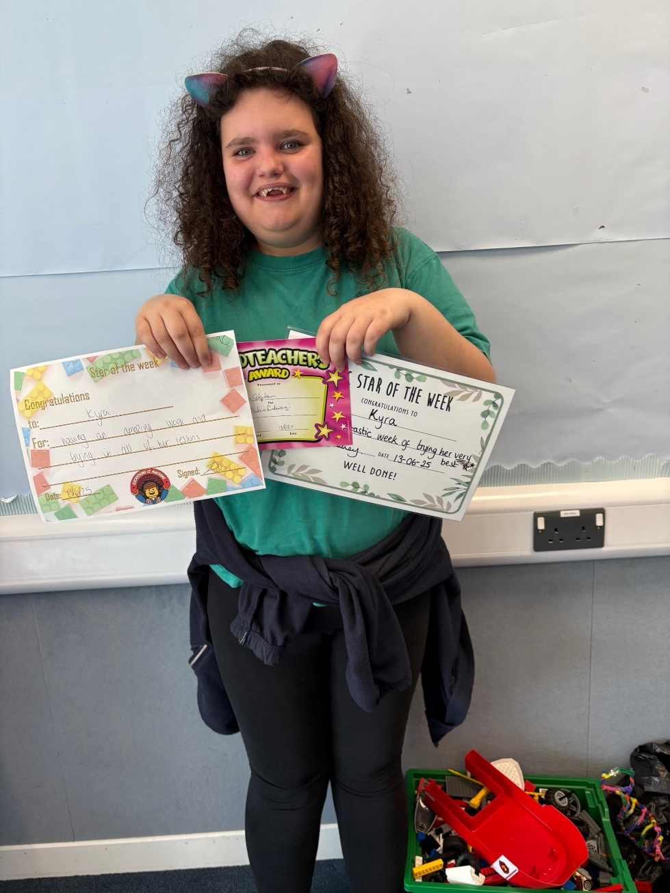

behaviour
Repair and rebuild, problem solve how we could do things differently next time, fix a problem, catch up on work.
Logical and/or safety consequences.
Class Dojos, in class rewards, Star of the Week, Headteachers award.

Slide 12
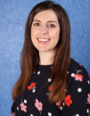
safeguarding
Samantha Elliott – Designated Safeguarding Lead overseeing a team of Deputy Designated Safeguarding Leads.
Culture of listening, non judgmental, open. We can and do help families.
Working in partnership with other agencies
Huge focus in our curriculum – e-safety, NSPCC Pants, alert buttons on iPad technology

Slide 13
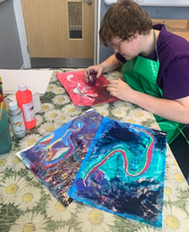
wellbeing
Karen Rowland – Head of Wellbeing
Triaged by need using SDQ data and referrals from staff, in consultation with families.
Therapy may be individual: CBT, Creative, Drawing and Talking, Psychodynamic or Sound.
It may be group: social prescription, therapy farm, group sessions on resilience, social regulation, healthy lifestyles.

Slide 14
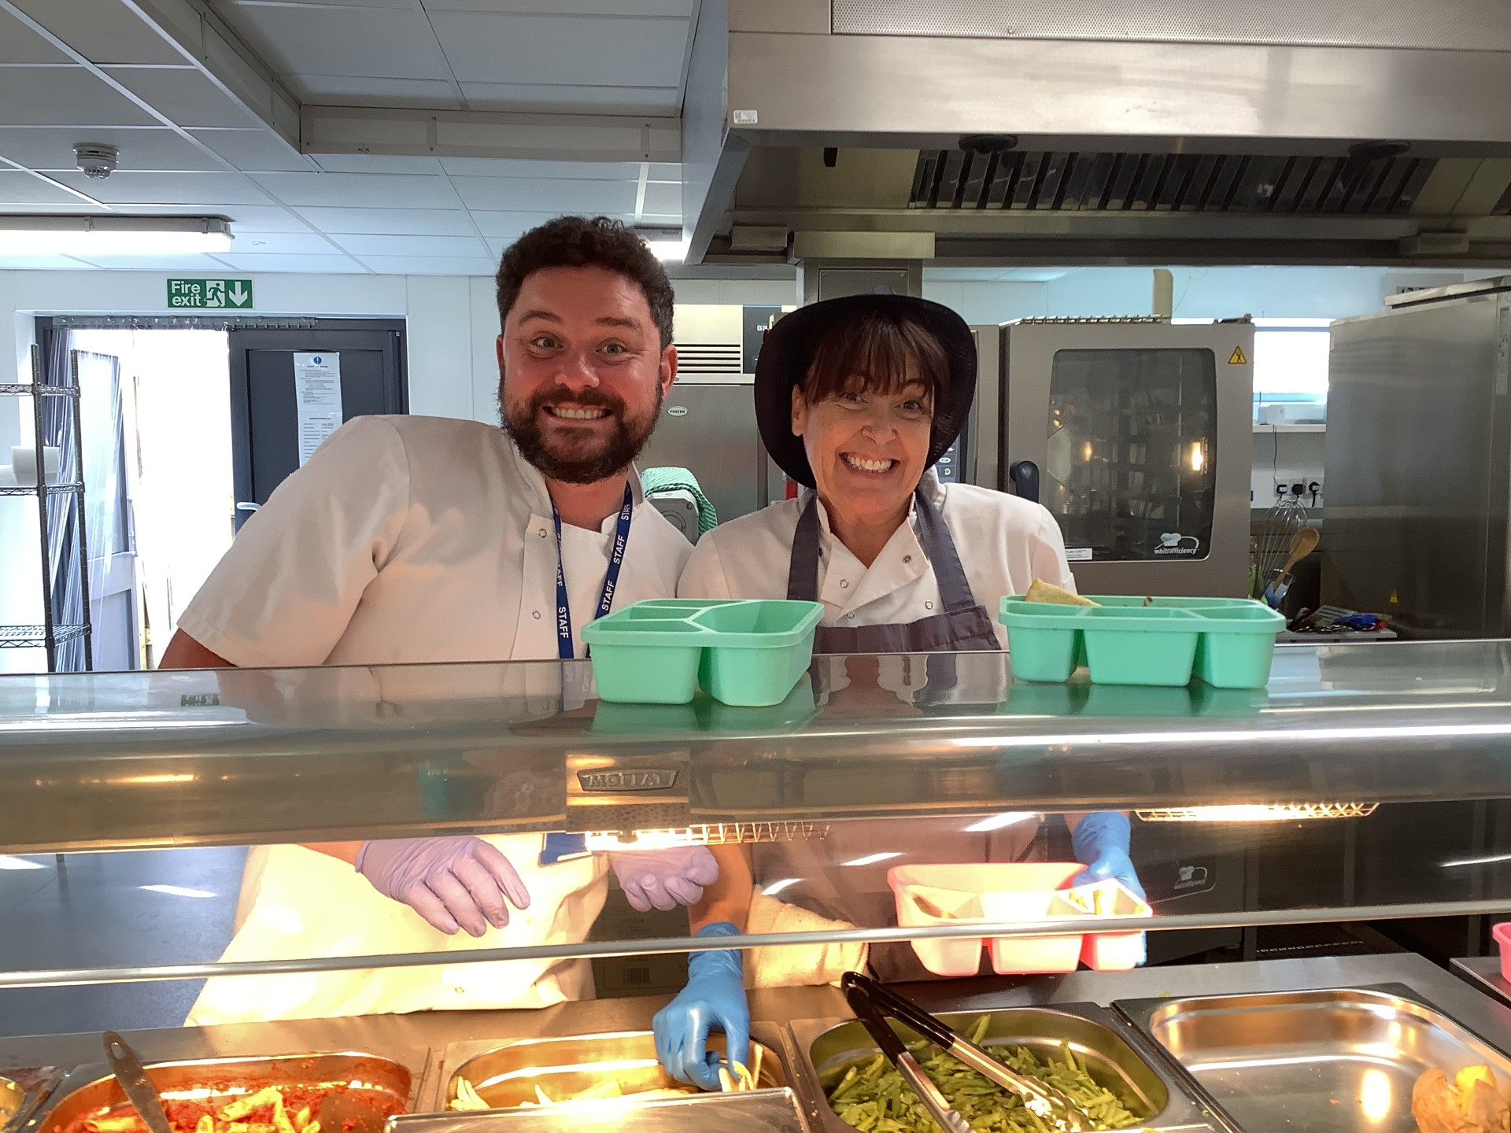
Free school meals
If your child is in or is joining EYFS, Year 1 or Year 2, they are entitled to UIFSM.
If you receive income support, income-based jobseekers' allowance, income related employment and support allowance, guaranteed element of pension credit, child tax credit or universal tax credit, you are entitled to claim Free School Meals.
If you think you do, please see our admin team and they will help.

Slide 15
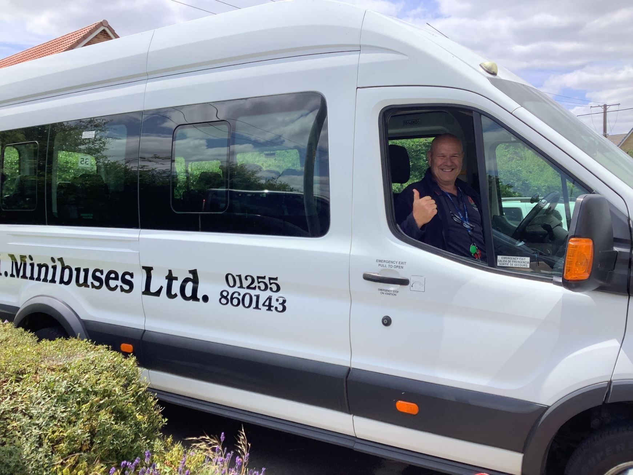
transport
Transport is NOT organised by the school.
You will need to apply for transport, using the forms in your welcome packs.
Our transport provider, through the manager, works closely with the school.

Slide 16

Diary dATES
Tuesday 30th June– 10-2, Transition Day. Meet new teachers and classmates. Please bring packed lunch.
Thursday 4th September: Start of term. New students only.

Slide 17

Who to contact?
If your child will be absent, call the main office: 01206 825195
If you have any questions about your child on a day to day basis, contact the class teacher.
If you have a concern that is bigger than the class teacher, please email admin@marketfield.essex.sch.uk and they will forward as appropriate.

Slide 18
ANY QUESTIONS?

